Slide 1
DRIVER DROWSINESS DETECTION USING DEEP LEARNING
CHANDU CHANDRA
SHAMBHAVI SOMPALLY
KALYAN KUMAR SAIEMPU
RAJASEKHAR CHINTHANIPPULA

Slide 2
INTRODUCTION
Numerous automatic driver sleepiness detection systems have been studied in recent years in academic and industrial research, but none are now employed extensively in day-to-day life due to excessive cost or insufficient effectiveness.
In this project, we make an effort to address this issue by introducing a real-time driver drowsiness detection system that makes use of computer vision techniques to watch and analyze a driver's face and notify them when they start to nod off.

Slide 3
DATA COLLECTION
We have used dataset named MRL Eye dataset which consists of 84,898 images. This dataset includes low- and high-resolution infrared photos that were all taken under varied lightning situations and with various equipment.
Every image is annotated so that every number in the name of image describes the eye state and specifications.
LINK for dataset : http://mrl.cs.vsb.cz/eyedataset

Slide 4
DATA PREPARATION
At first we created two different folders named closed eyes and open eyes. With a small python code separated all the images into the folders which are created using shutil and other commands to copy and paste images.
Then again we created train and test folders. Train folder contains 20% of the close and open eyes, test folder contains 80% of the close and open eyes.

Slide 5
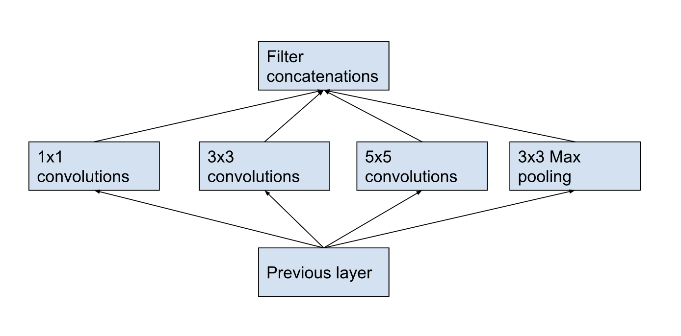
MODEL TRAINING
Here for this project we used INCEPTION-V3 model.
It is a convolutional neural network architecture of 48 layers deep from the Inception family called Inception-v3 includes a number of advances, including employing Label Smoothing, Factorized 7 x 7 convolutions, and the inclusion of an auxiliary classifer to transport label information lower down the network (along with the use of batch normalization for layers in the sidehead).

Slide 6
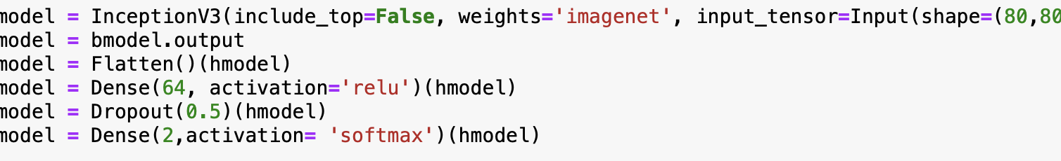
MODEL TRAINING
To lessen the computational complexity, we added MaxPooling to the output of the inception v3 feature extractor. In order to avoid over-fitting and cut down on computational costs, a MaxPooling layer operates by down sampling the input and lowering its dimensionality.

Slide 7
MODEL TRAINING
Added ModelCheckpoint to save the model at where it found good accuracy among the epochs, EarlyStopping to reduce overfitting, and ReduceLROnPlateau to reduce the learning rate.
Overall, our model had a 94.77% accuracy but what is more significant is the consistent model performance in the different scenarios.

Slide 8
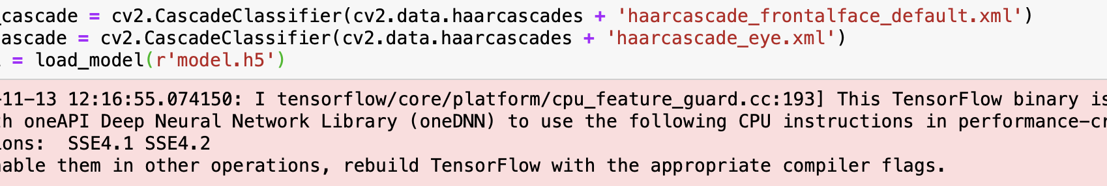
VIDEO CAPTURE AND DETECTION
For facial detection we used haarcascade which is One of the popular algorithms for facial detection. It is computationally less expensive, a fast algorithm, and gives high accuracy.
Additionally, a cascade classifier is applied, which is used to enable negative input (non-face) to be quickly discarded while investing more compute on promising or positive face-like regions. It greatly speeds up processing and improves workflow.

Slide 9
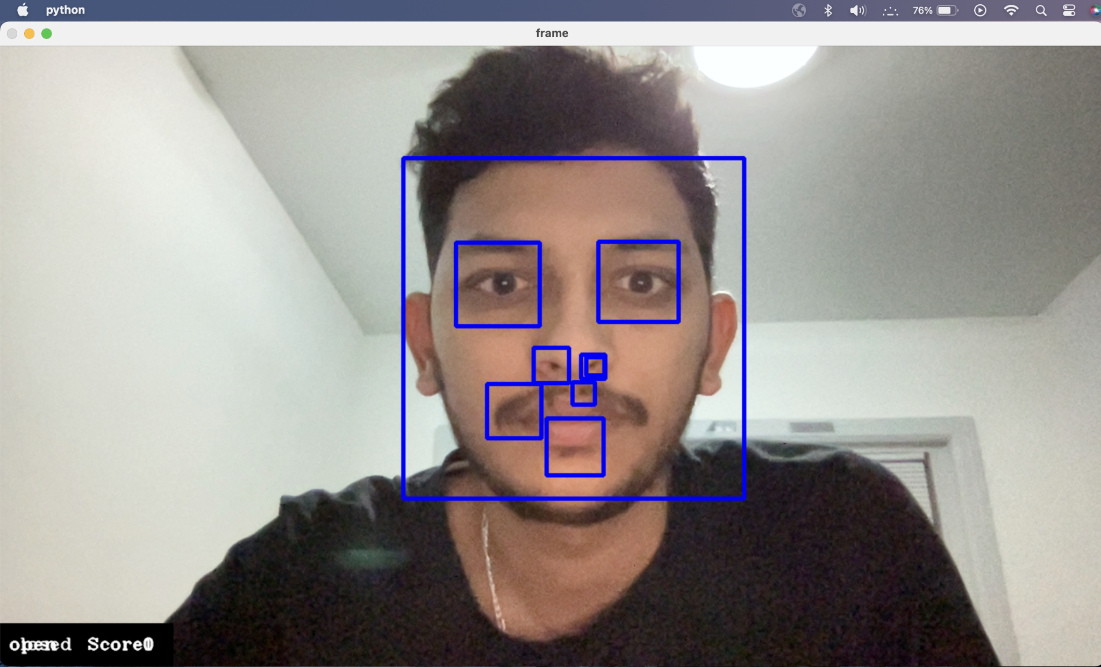
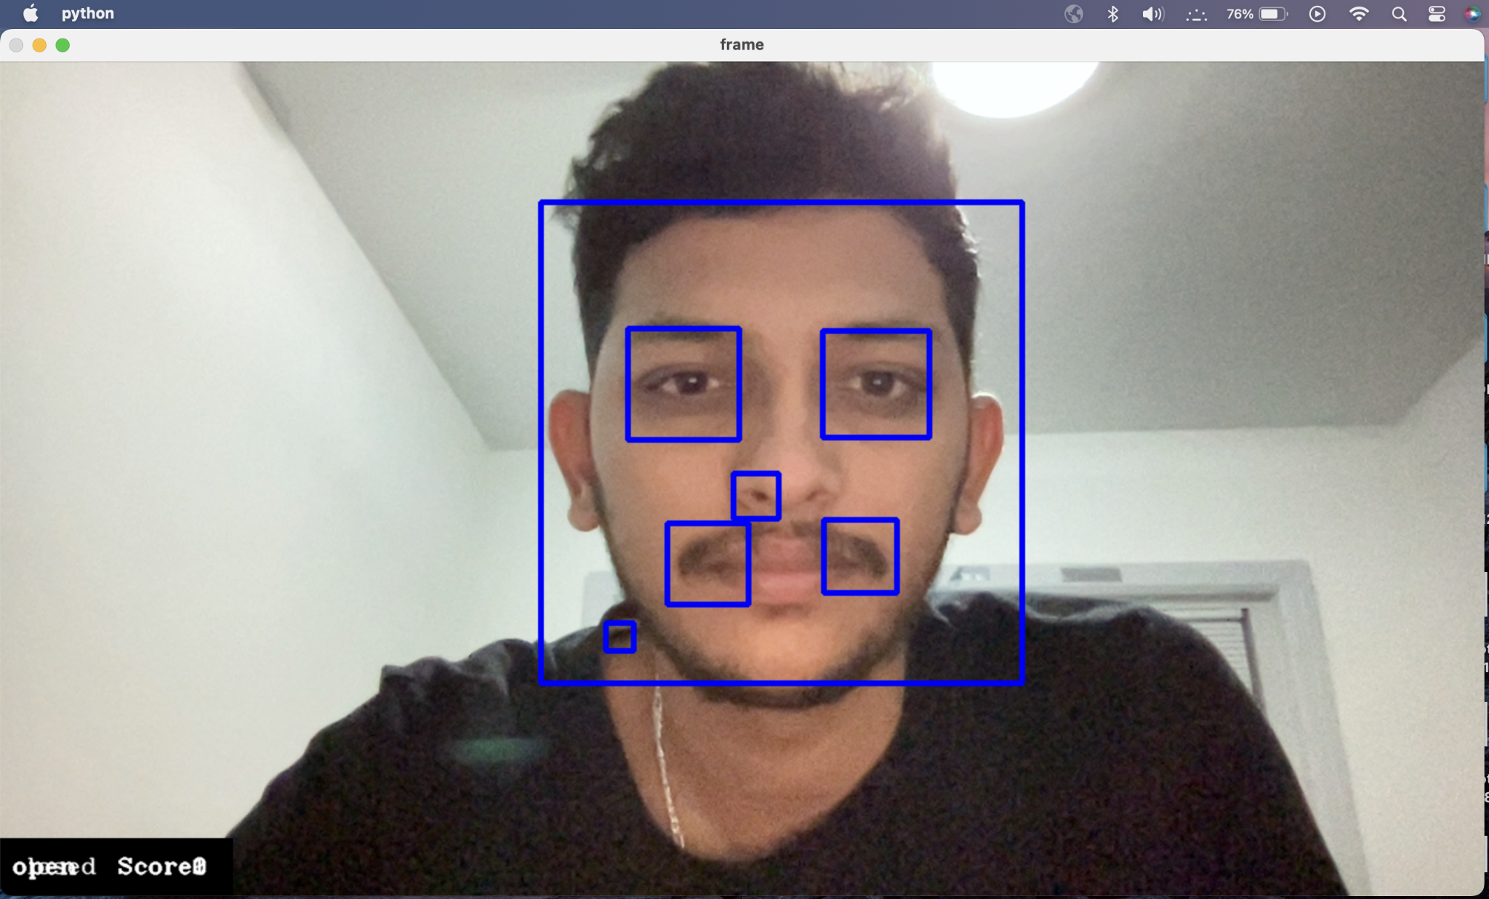
RESULTS
Whenever eyes are closed the score increase by 1 and whenever the score reaches 15 the alarm starts to ring.

Slide 10
OBSERVATIONS AND CHALLENGES
Initially we have used VGG-16 which has given a very less accuracy of 72.64% so, we replaced it with Inception-v3 and after training the model with only one epoch we have got an accuracy of 89.84%.
Then after setting five epochs we achieved an accuracy of 94.77%.
Model is performing good in daylight conditions and without spectacles when compared to low light and with spectacles.

Slide 11
FUTURE WORKS
Instead of cascade classifier, For better feature extraction HOG(Histogram of Oriented Gradients) or DLIB(It’s a landmark’s facial detector) can be used.

Slide 12
THANK YOU

